Slide 1

GREEN QR: SMART TREE INFORMATION SYSTEM
by
A Chaithanya
Roll No. 224G1A0513
B Shantha Vardhan
Roll No. 224G1A0597
V Likith Kumar
Roll No. 224G1A0542
Under the guidance of
Dr. P. Veera Prakash , M.Tech, Ph.D
Assistant Professor
Department of Computer Science and Engineering
Srinivasa Ramanujan Institute of Technology
Autonomous
Rotarypuram Village, B K Samudram Mandal, Ananthapuramu – 515701.
Accredited by NBA & NAAC with “A” Grade,Affiliated to JNTUA,Ananthapuramu
2025-2026

Slide 2
Contents
Problem Statement
Objectives
Methodology
Implementation Details
Expected Outcomes/ Results

Slide 3
Problem Statement
In many areas, there is no proper system to monitor planted trees. Information about trees such as species, age, maintenance history, and environmental benefits is not easily accessible. Manual record-keeping is inefficient and prone to data loss.
This lack of organized data management makes it difficult for authorities and institutions to monitor tree growth, survival rate, and maintenance activities effectively. It also reduces public awareness about the importance of trees and environmental protection.
Therefore, a smart digital solution is required to:
Store tree information securely
Track plantation activities
Provide easy public access to tree details
Support environmental conservation efforts
Such a system will improve transparency, accountability, and efficiency in managing plantation programs while promoting sustainable environmental practices.

Slide 4
Objectives
To develop a user-friendly mobile application that enables efficient digital management and monitoring of tree information.
To generate and assign unique QR codes to each tree so that every tree can be individually identified, tracked, and linked to its specific data within the system.
To enable users to scan the QR codes using the mobile application and instantly access comprehensive details about the tree, including species, age, plantation date, and environmental importance.
To create and maintain a secure and well-structured digital database that stores tree information, plantation records, and maintenance details for long-term monitoring.
To support effective plantation monitoring, improve transparency in environmental programs, and promote environmental awareness among students, institutions, and the general public.

Slide 5
Methodology
Collect tree data
Gather detailed information such as species name, location, plantation date, and environmental importance through field surveys and records.
Store data in the database
Organize and store the collected information in a secure digital database for reliable management, easy updates, and quick retrieval.
Generate unique QR code
Create a unique QR code for each tree that links the physical tree to its digital profile, ensuring individual identification without duplication.
Attach QR codes to trees
Print and laminate QR codes for durability and securely fix them to trees for easy scanning in real-world conditions.
Develop mobile app for scanning
Build a user-friendly mobile application with a camera-based QR scanner for smooth navigation and efficient scanning.
Display tree information
Retrieve tree data instantly from the database after scanning and display it clearly on the screen for easy understanding.

Slide 6
Implementation Details
User Authentication
The application provides a secure authentication system to ensure that only registered users can access the the features, protecting user data and maintaining system security.
User Registration (Sign Up), User Login, Secure authentication system
Registration Module
New users can create an account by entering their personal details. This module collects the necessary information for identification and future login.
Name, phone number, email, password
Login module
Registered users can log in using their credentials to securely access the system and its features.
Email, password
Tree information module
After logging in, users can scan the QR code attached to trees to view detailed information such as species, plantation date, and environmental benefits.
Scan QR code attached to trees, View tree details, Access environmental information

Slide 7
Implementation Details
QR Code Scanning:
The application uses the mobile camera to scan QR codes. Once scanned, the system instantly retrieves the stored tree data from the database.
Camera permission enabled, QR scanner integrated
Instantly retrieves tree data
Database Management:
All tree and user details are stored securely in a digital database, ensuring safe storage and quick access whenever required.
Tree details stored digitally, User data securely maintained
Real-time information retrieval
Working Model Demonstration:
The working model demonstrates the complete functioning of the system, from user registration to scanning QR codes and displaying tree information, showing how digital technology supports environmental monitoring.
User registration, User login
QR code scanning, Display of tree information
Technologies: Kotlin, Zxing(library).

Slide 8
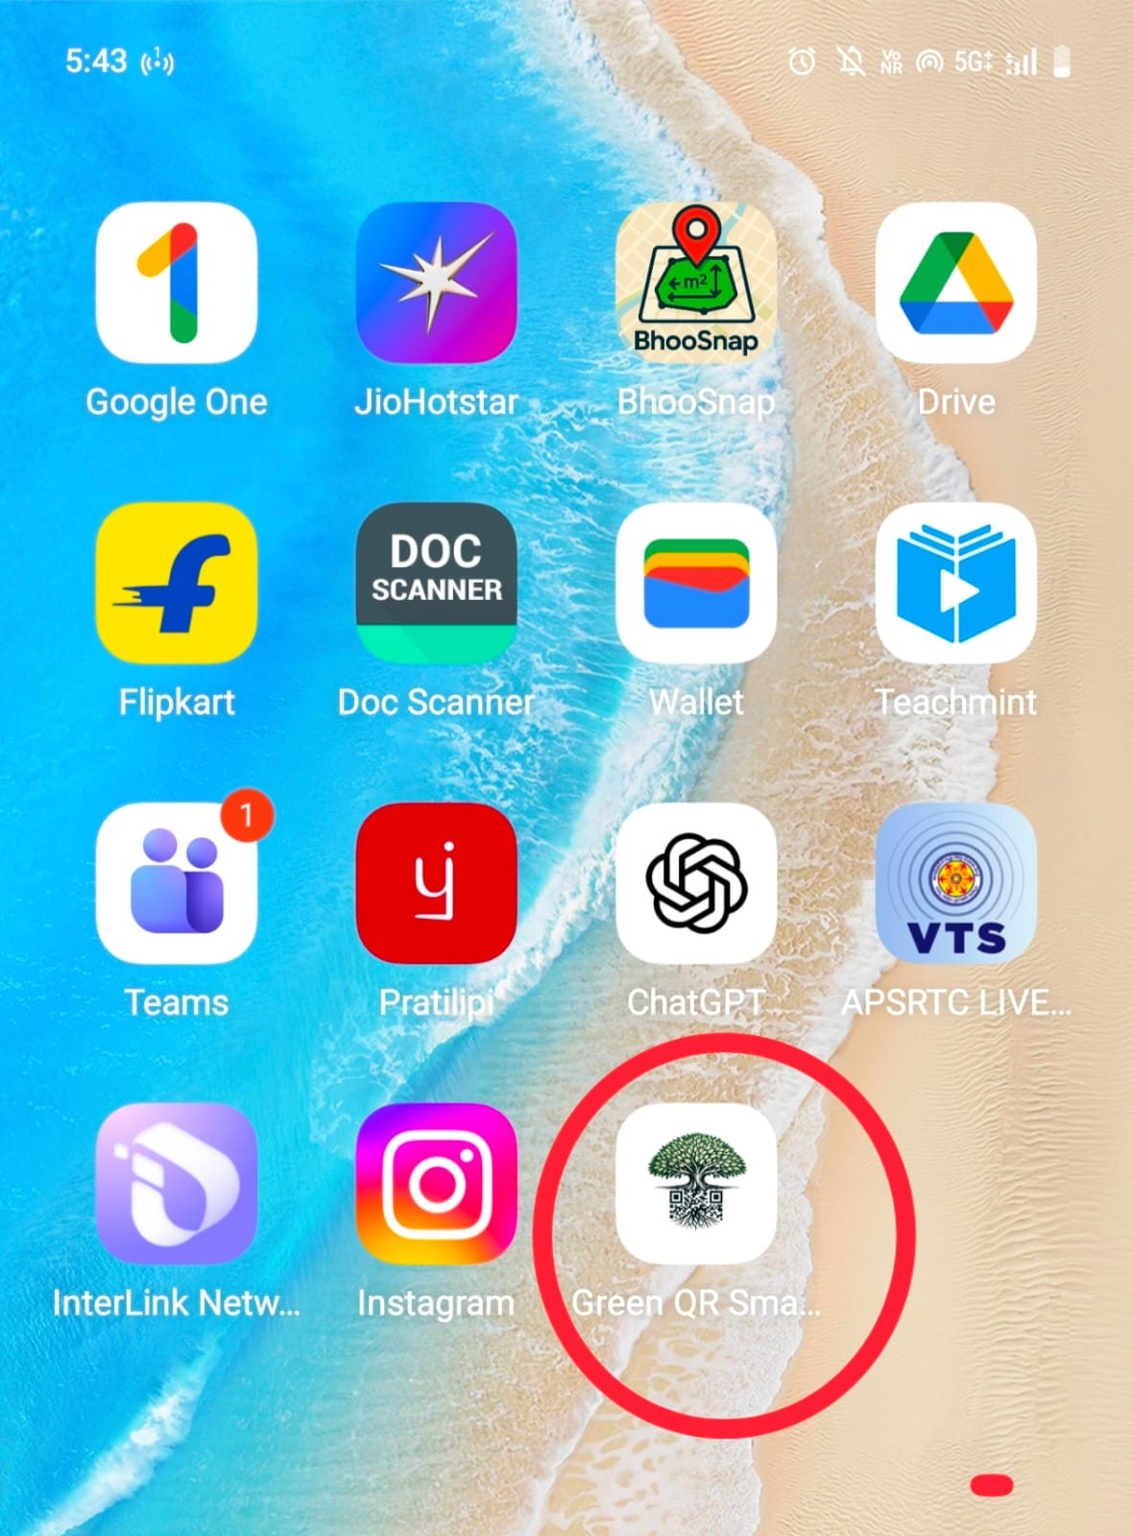
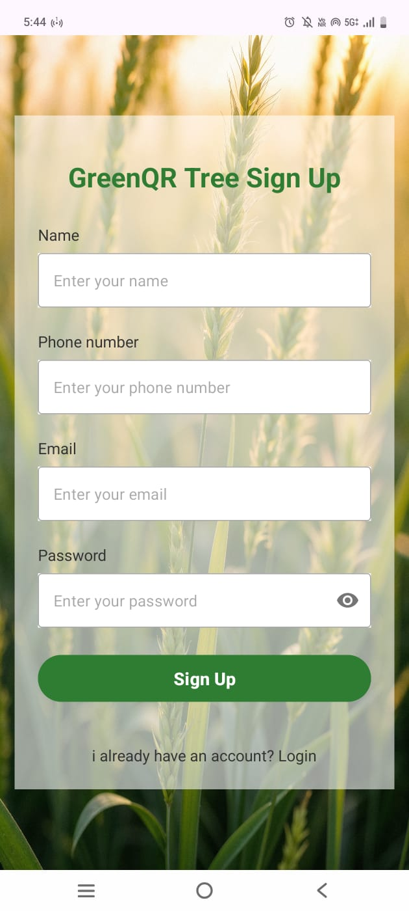
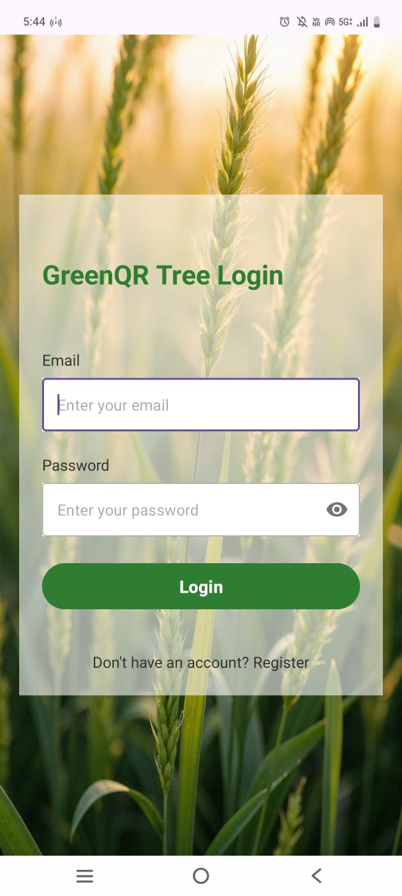
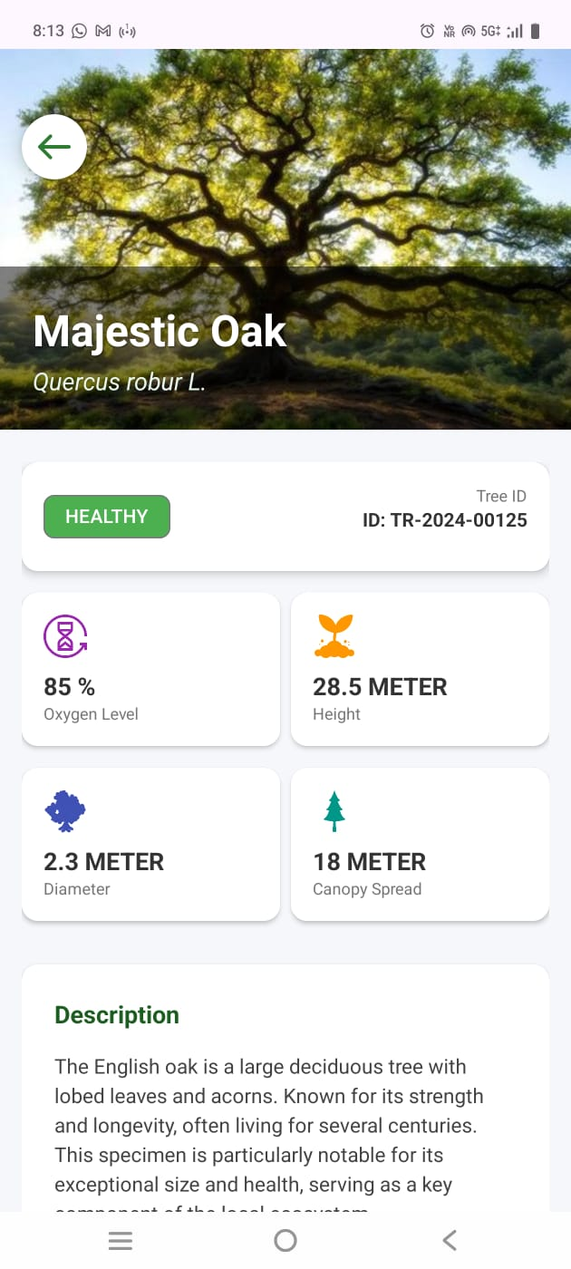




Expected Outcomes/Results

Slide 9
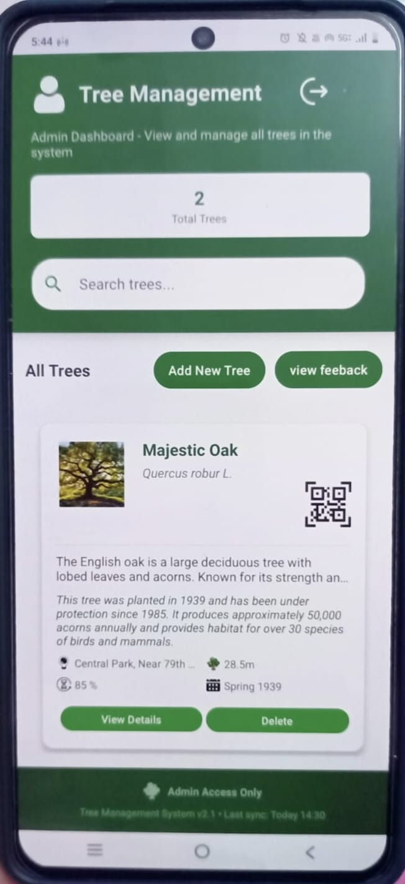
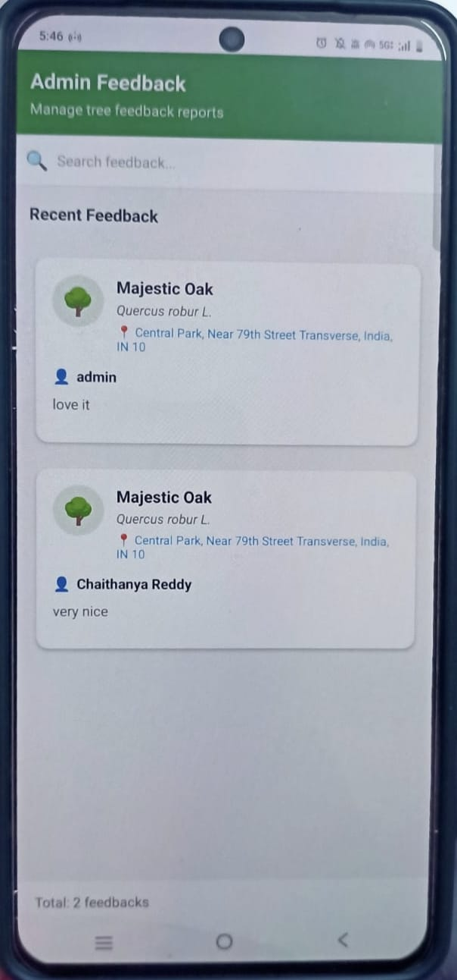
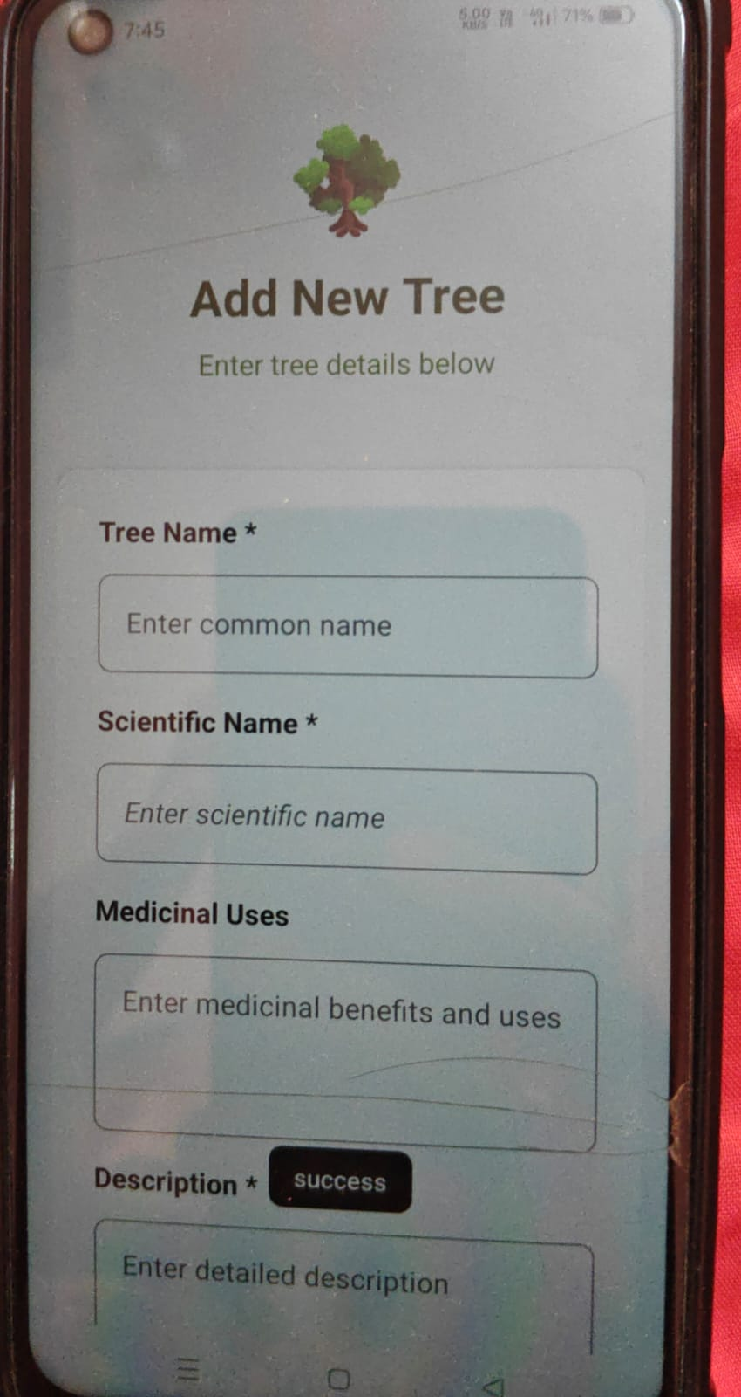
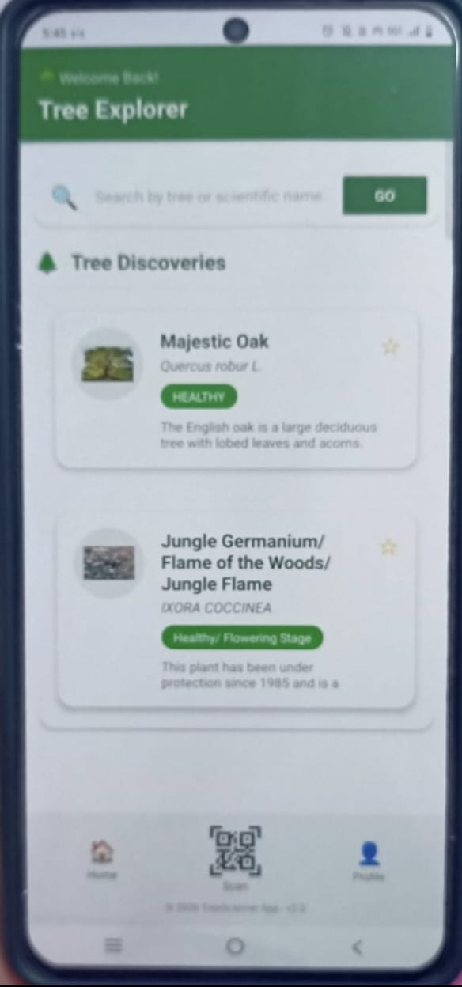



Expected Outcomes/Results
After admin and User login
Adding Tree Details

Slide 10
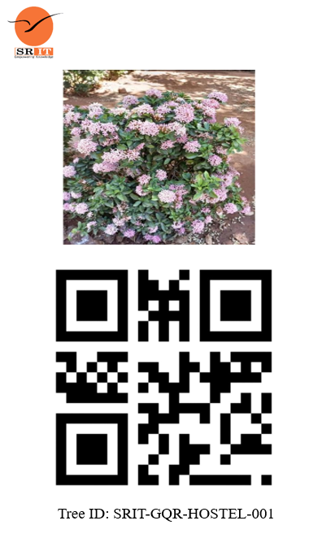
Expected Outcomes/Results

Slide 11
Thank You

Slide 12
Any Queries

